Slide 1
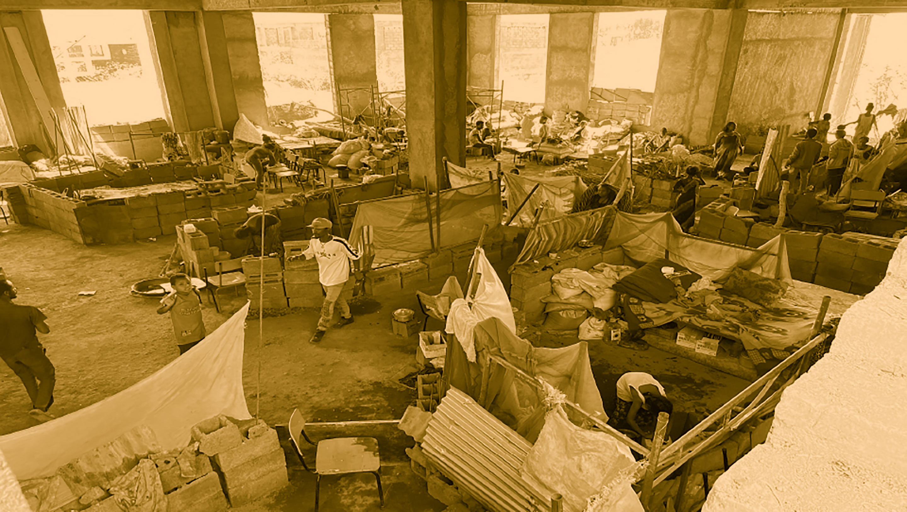
Tigray
Gender Analysis

Slide 2
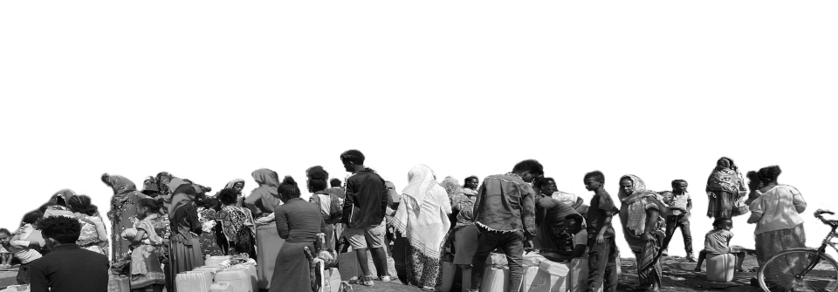
Agenda
Objectives of Rapid Gender Analysis
Methodology and approach: sample, validation, limitations, DQA
Findings
4. Recommendations

Slide 3
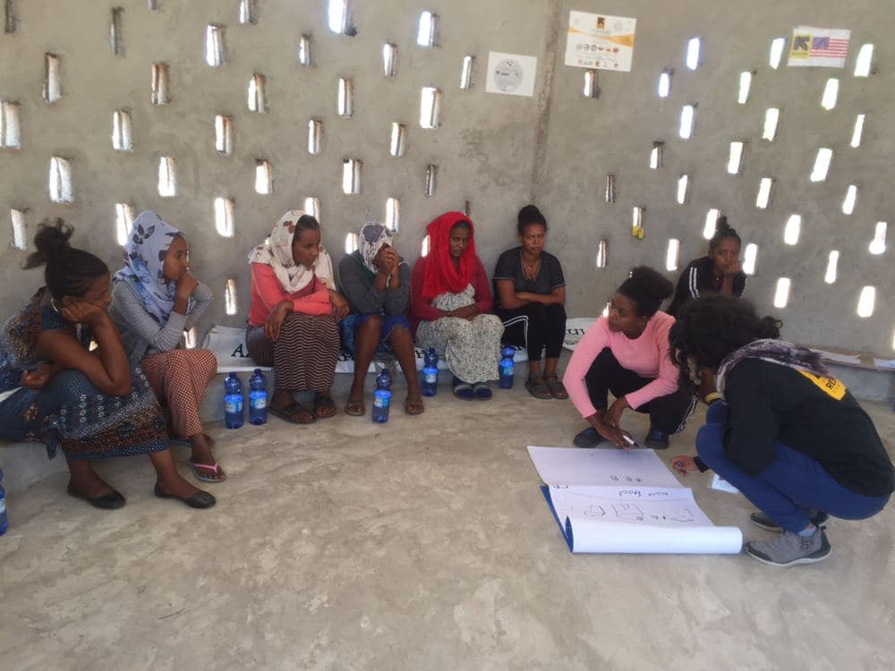
Objectives
To understand how the crisis is affecting diverse groups (men, women, boys, girl, PWD)
To ensure that IRC’s emergency programming is responsive to the unique needs, priorities and constraints of different client groups

Slide 4
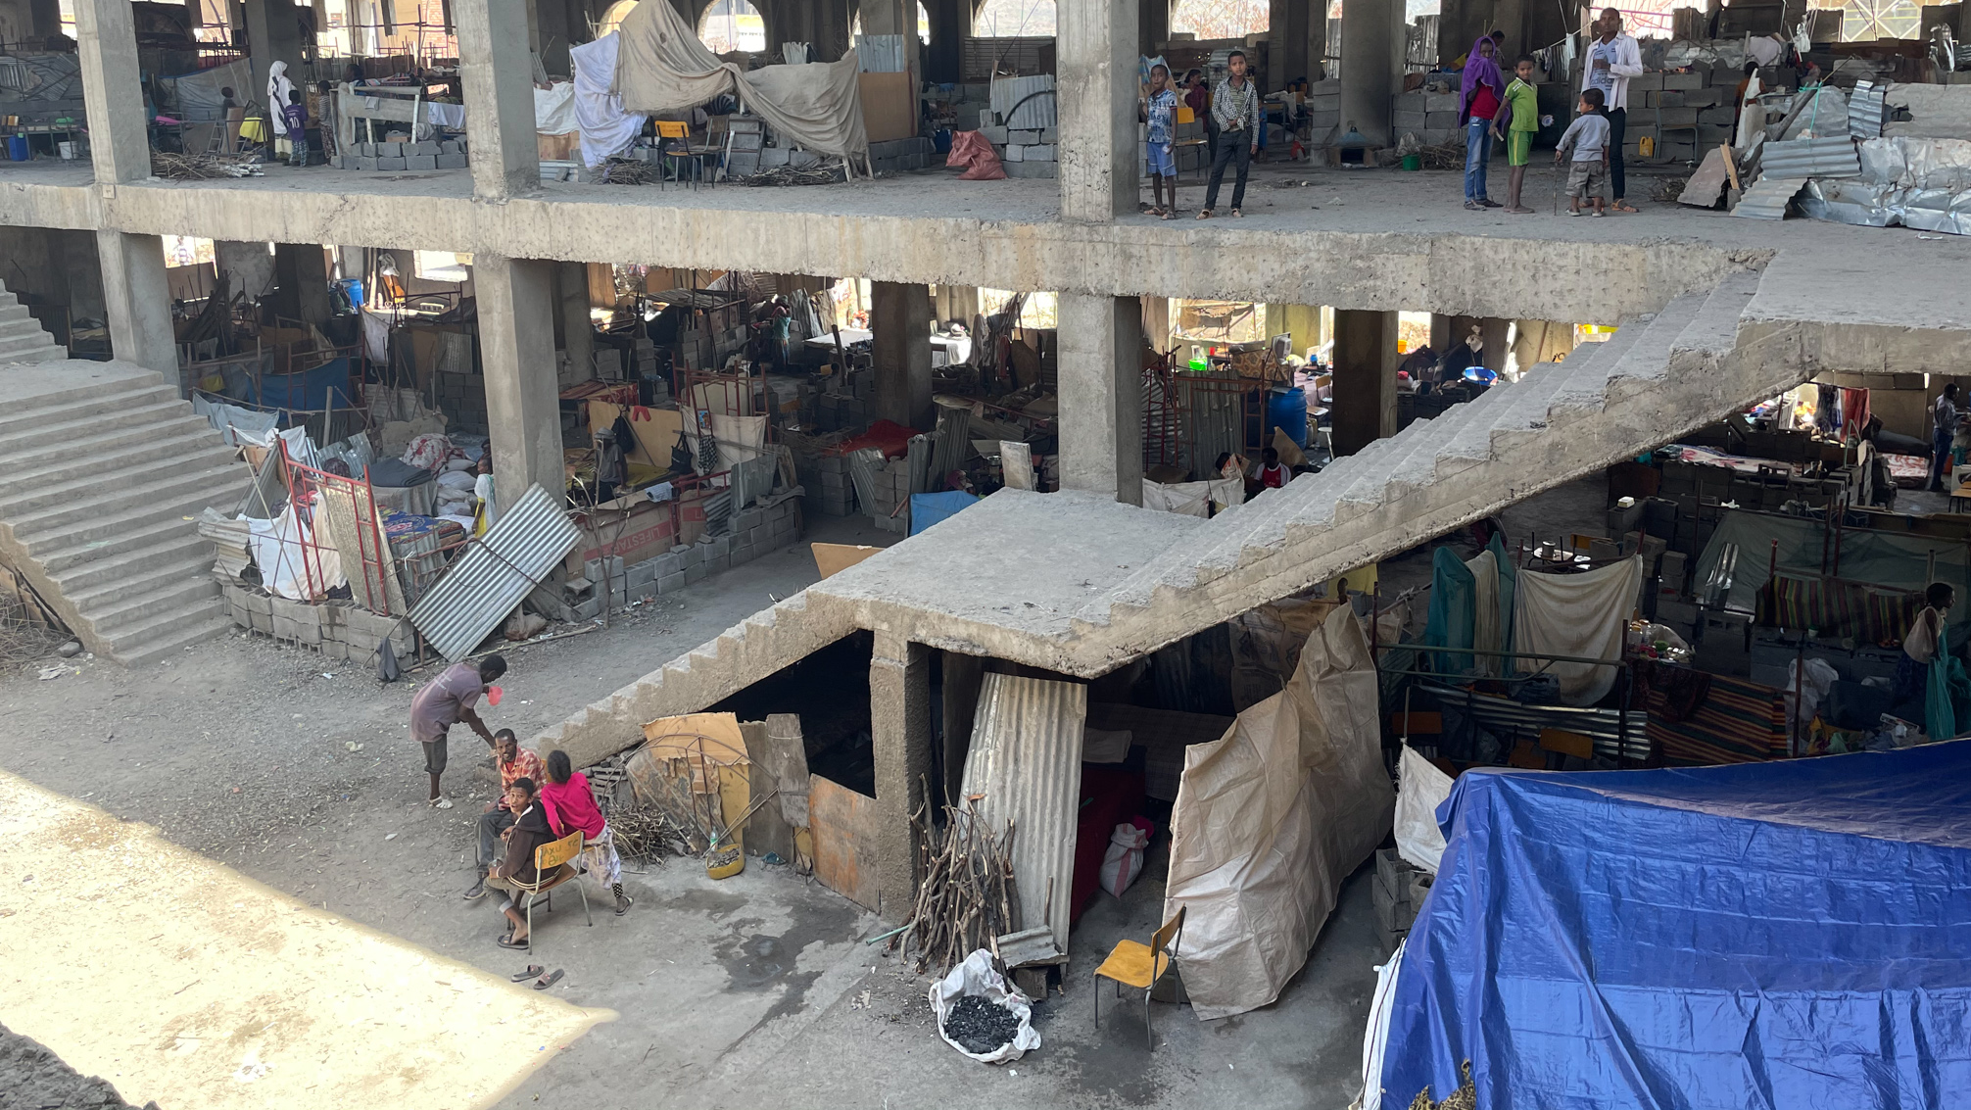
Methodology and Approach

Slide 5
Methodology and Approach
Sample:
186 clients engaged (49% women and girls; 51% men and boys; 18-35 years (57.8%); 36-55 (36.8%); 65+ (5.2%)
Desk review:
Analysis of 34 gender related news reports from news agencies, UN agencies and INGOs between 12th November to 31st March.
Validation:
Round 2: 6 KIIs on specific topics
3 validation calls with the Tigray team
Interviews with Sector Leads
Validation webinar!
Timeline:
March 2021 – April 2021.
Literature review of 34 documents
Round 1: KIIs with 12 clients and 4 stakeholders
Limitations:
Network coverage
Competing priorities of project teams.
Urgent need for report - Round 2 on specific topics called off
Round 2: 6 targeted KIIs

Slide 6
Data Quality Assurance
Structured Interview Guides. FGDs/KIIs designed to draw out details during data collection (e.g., more prompts, before and after pictures to show comparison).
Train the Trainers. Research leads received training before traveling to Tigray to oversee data collection.
Safety Considerations. Asked sensitive questions on GBV in interviews, not FGDs.
Validation calls. Follow-up calls booked where more details were needed.
Triangulate. Compare findings across multiple data sets: FGDs with clients, KIIs with clients and stakeholders, desk review.
Quantity. Incorporate quantitative metrics into FGDs (e.g., % of FGDs that agreed/ disagreed with an issue).

Slide 7
Locations: Six sites locations across Tigray
Shire - Axum University, IDP camp
Shire - Embadanso, IDP camp
Mai Tsebri. IDP camp
Shire – school, IDP camp
Mai-Ayni Refugee Camp
Adi-Harush Refugee Camp

Slide 8
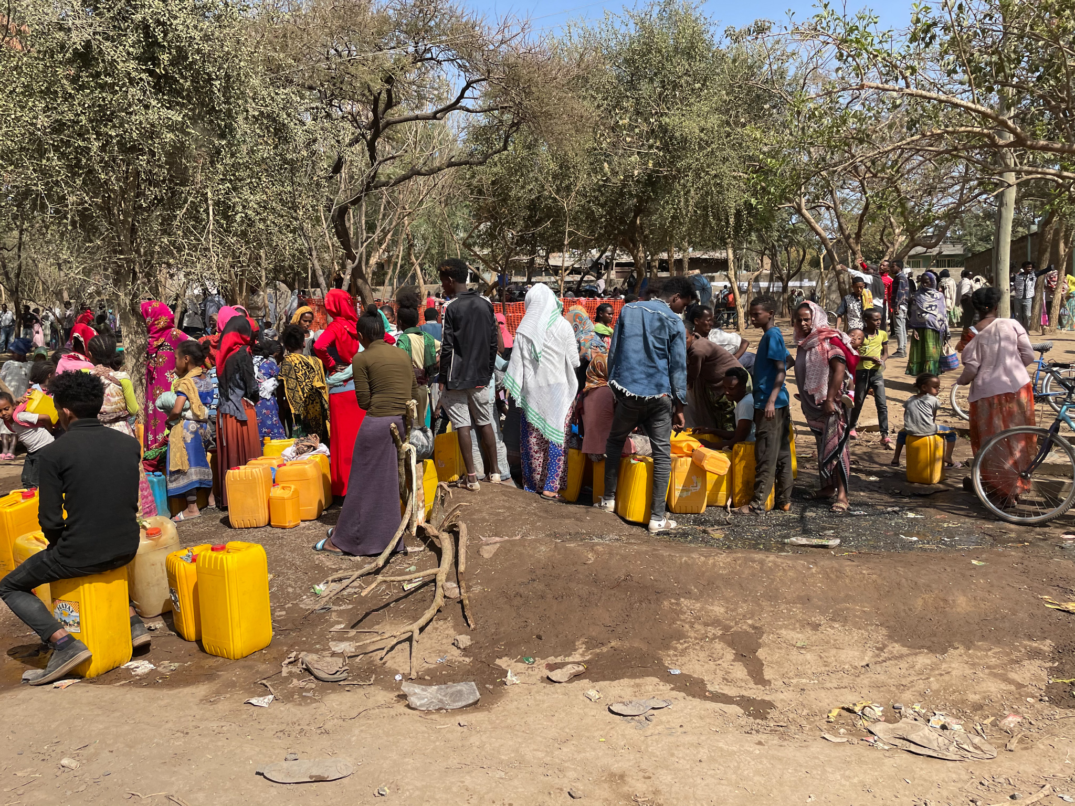
Findings:
Livelihoods
Gender-Based Violence (GBV) and client safety
Gender dynamics and social norms
Access to aid (Food, shelter, WASH, health)
Findings: Livelihoods, Food Distribution & Negative Coping Strategies

Slide 9
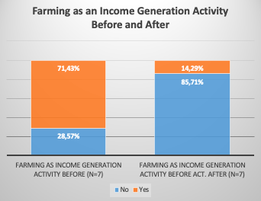
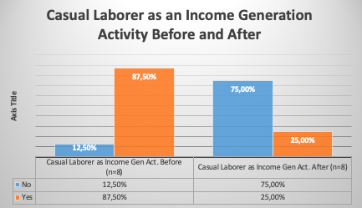
Four main livelihoods and income streams impacted
Insight #1: Men and women reported that four key income streams had been reduced : 1) Farming, 2) Petty trade, 3) Casual labor, and 4) Remittances (for men only)
Insight #2: Changes in livelihoods has impacted men’s role; how men ‘see themselves,’ sense of identity as breadwinner
Insight #3: Women face more challenges than men. Childcare responsibilities, work-related taboos, and inability to access remittances undermines ability to access diverse livelihoods/income streams
Petty Trade

Slide 10
Limited food supply, households divide rations, and new arrivals at particular risk.
Insight #4: Insufficient food supply. Adults not eating to ensure children have food. No evidence of gender preference for food distribution in the home; rather preference for children eating first.
Insight #5: Households divide food supplies. Households ‘splitting 1 food ration’ (e.g., divide one bag between 2-3 households)
Insight #6: New arrivals lack ID cards and cannot access supplies. New IDPs from Shimelba and Histast especially vulnerable -rations late, no registration cards, live on edge of camp where insecurity is highest (theft of FIs and NFIs from fellow IDPs, fear of GBV).

Slide 11
Gender Analysis Trends – Sexual Exploitation
Insight #7: Lack of food, income streams and livelihoods opportunities is forcing female refugees/IDPs into sexually exploitative relationships to meet basis needs.
Insight #8: Female heads of households, single women and young women were believed to be at greater risk.
Insight #9: Most prevalent in four locations (Bada, Shire, Mai Aini refugee camp, Mai Tsebri IDP camps)

Slide 12
Gender Analysis Trends – Sexual Exploitation
Insight #10: Lack of food, income streams and livelihoods opportunities is forcing female refugees/IDPs into sexually exploitative relationships to meet basis needs.
Insight #11: Female heads of households, single women and young women were believed to be at greater risk.
Insight #12: Most prevalent in four locations (Bada, Shire, Mai Aini refugee camp, Mai Tsebri IDP camps)

Slide 13
Gender Issues in Food and NFI Distribution
Insight #13: Young men falsely ‘claim FIs and NFIs (dignity kits) on ‘behalf’ of women.
- Food packages going to young men
- Menstrual hygiene kits going to men and re-sold
Insight #14: Distribution points unsafe for women and girls after dark. Lines take ½ day, roads are unsafe to travel on. Women in particular abandon lines without food at 5pm to reach shelter before nighttime.
Insight #15: Sexual harassment with ethic slant in some cases (e.g., catcalling female refugees by their ethnic group.

Slide 14
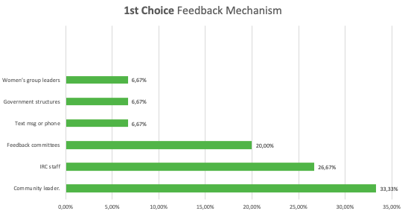
Client Reporting Mechanism: No Clear Mechanism in Place
Insight #16: Preferred feedback mechanisms were:
Community leaders (33.3%)
IRC staff (26.7%)
Feedback committees (20.0%)
Least preferred feedback through:
Women’s spaces (non confidential). Text message or phone calls, Government structures, Personal visits/ contacts.
Female Respondents also REQUESTED :
Elected female representatives

Slide 15
Findings: Changes in Household Dynamics

Slide 16
Changes in Household Dynamics
Insight #17: Marked increase in numbers of FHHs, due to family separation, men who were killed during conflict, or migrated in search of work or to join armed forces. Consequences for women:
Growing household decision making
Enhanced risk/vulnerability
Psycho-social pressure (‘need to manage everything, make all decisions’)
Insight #18: Men and women more likely ‘to be idle’ - no IGAs, no social activities + trauma = focus on the past. Both have more time to think about the past
Insight #19: For families that remain together, increase in tension/conflict.
‘Married couple tend to fight more than they used to prior to the war. Some people still live with their wives and some have abandoned them. Prior to the war there were activities that would keep people keep engaged and there were many services they could participate in. Now that everyone is idle and spends a lot of time together they fight a lot.’
FGD with 18–21-year-old female refugees in Mai Ayni on 27th February 2021.

Slide 17
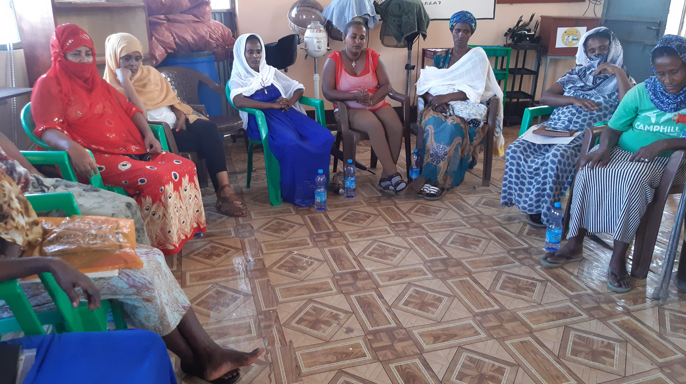
Findings: GBV and Protection

Slide 18
Shelter & Safety in Camps
Insight #20 : Shelter are insecure for women and girls, because of mixed sex sleeping arrangements (20-40 to one room), especially for unaccompanied minors
Insight #21: Camps have a porous border. Reports of strangers entering the camp at night and moving from shelter to shelter demanding cash and non-cash items. Women/new arrivals on outskirts of camps most vulnerable.
‘‘We are scared of men who are unfamiliar to us whether they are fellow refugees or local community members. We are scared of going to the toilets because we have heard that one woman has been killed and we are scared of facing the same fate. We also don’t feel safe going to the shower rooms. Peace keeping should be strengthened, and peace keeping bodies should be present at the camp site. In addition to that light would solve a lot of our problems, it’s the darkness that scares us.’
WR18-25 FGD, Adi Harush Refugee Camp

Slide 19
Trends in GBV –Conflict -Related
Low reporting of GBV.
No clear, safe reporting mechanisms, fear of reprisals
Breakdown of law and order leading to weakened accountability mechanisms
Economic uncertainty and lack of economic alternatives for women
Increased consumption of alcohol by men
Emphasis on basic needs sidelines conversations on GBV
Majority of cases reported to IRC involved rape of women and girls.
USAID/Insecurity Insights Report:
Locations: home (39%), camp (21%), walking on road (18%), hospital (11%), open area (11%), convent (4%).

Slide 20
Trends in GBV – GBV Continues to be Priority Concern
Insight #22: GBV continues and women’s vulnerability compounded by breakdown in social structures, accountability, sanctions for perpetrators, fear of retaliation, increase in alcoholism, lack of food/cash, exposure during conflict, disagreement between couples, lack of reporting mechanisms and services.
Insight #23: Tension in the home and Intimate Partner Violence (IPV) reported to be on the rise.
Insight #24: More social stigma against reporting than before, perception that there are “more pressing concerns” like hunger.
Insight #25: Lack of medical services for GBV survivors. Only Suhul hospital has PEP. Health workers not trained to receive cases. Survivors being turned away.

Slide 21
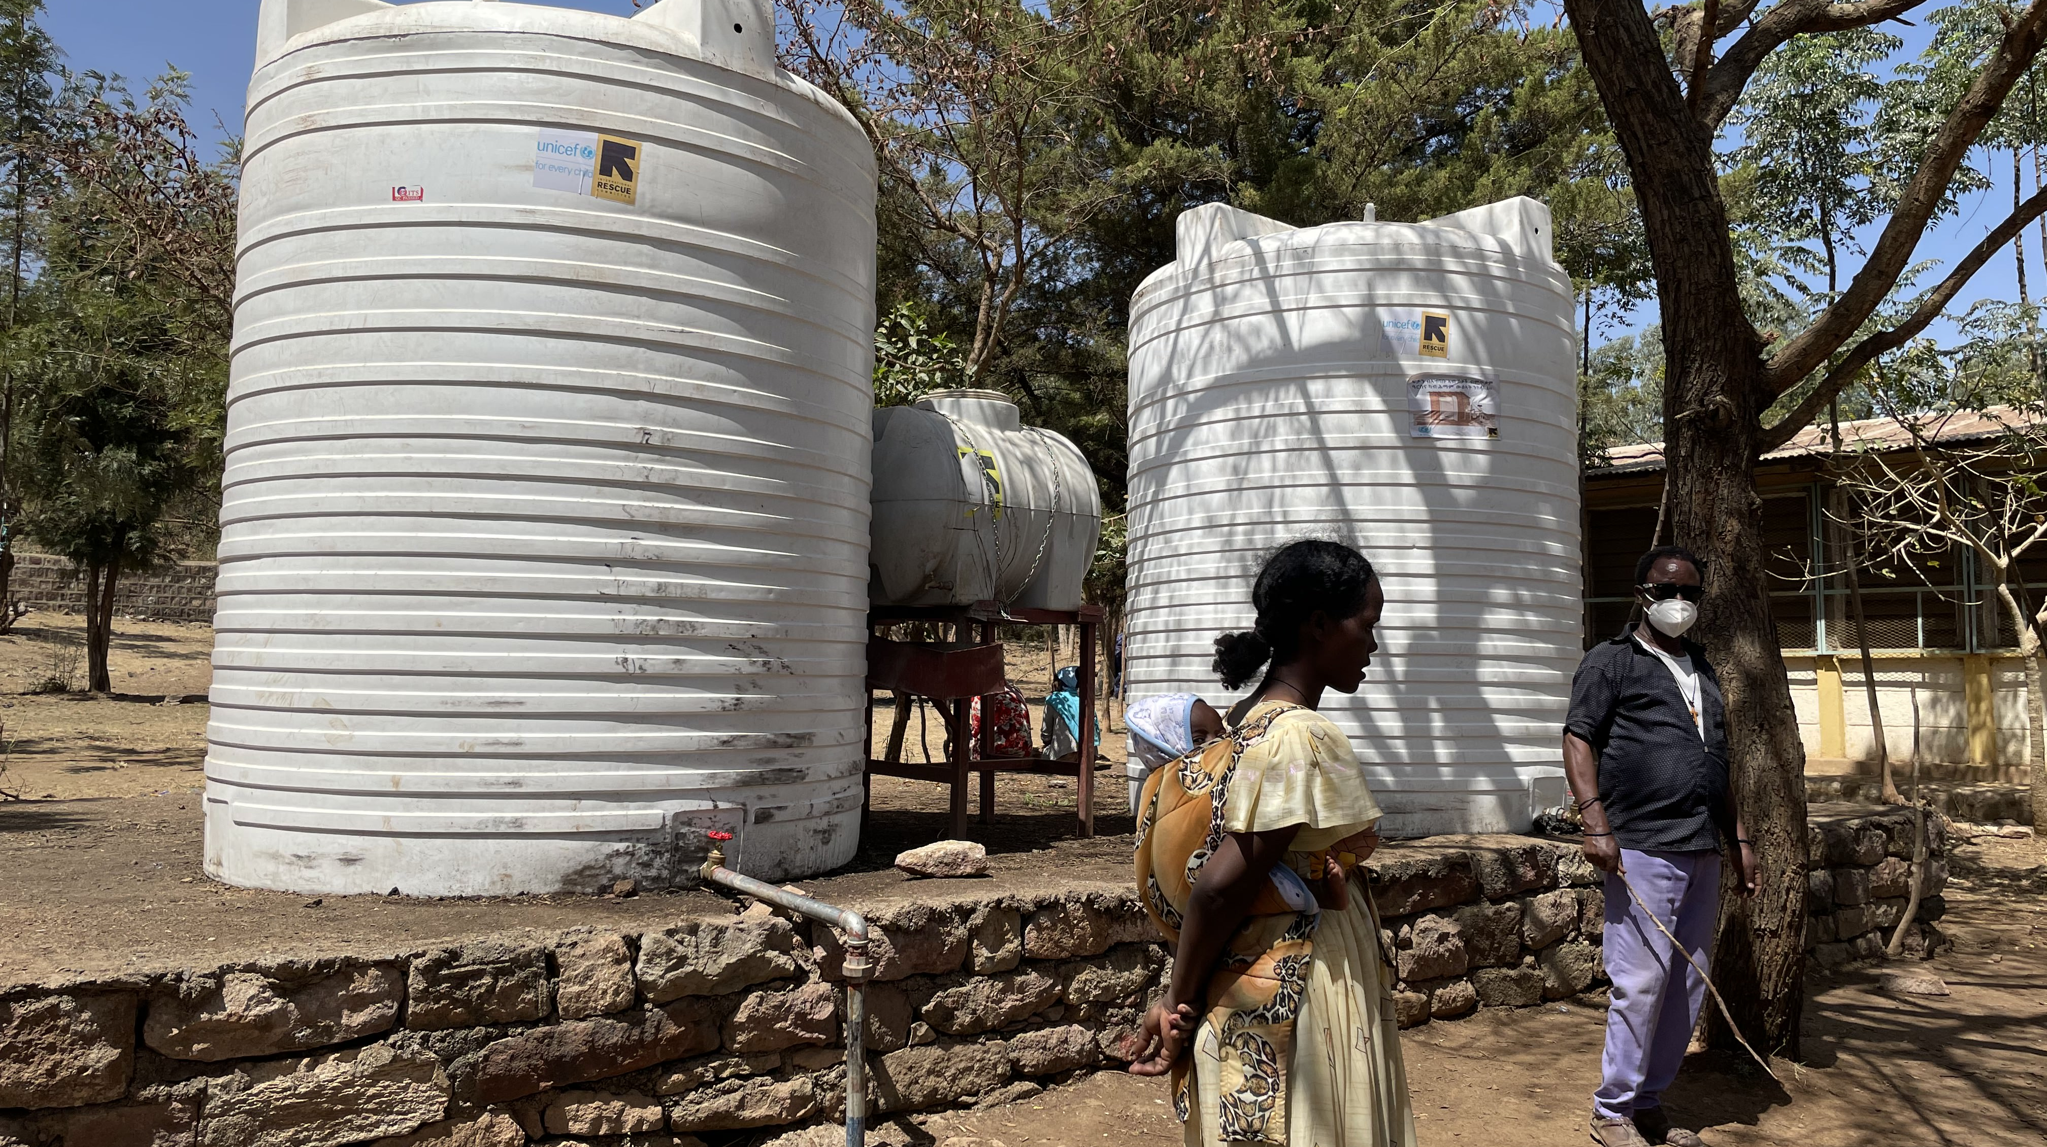
Findings: WASH

Slide 22
WASH: Overall
Insight #26: Low access to water but increased demand. Water not utilised by household, but by shelter (up to 40 people per shelter), all using same water point/jerry can.
Insight #27: Women spending more time collecting water. Due to limited supply forced to collect water at rivers outside camps,with increased exposure to GBV.
Insight #28: Toilets and wash facilities in all camps and IDP sites unsafe. Dirty, no soap, no maintenance, mixed-sex, no lights, no locks on doors, women/ girls unable to access toilets after dark, if off sites. Reports of increased UTIs for women.
Insight #29: Inadequate access to sanitary products. 50% of women’s FGDs reported, that they received dignity kits, 80% of this number only one distribution, shared between several women.
"There was a dignity kit in distribution, but it was really small in number and its mostly men who receive the kits. Theft of the kits is also another problem."
FGD with women

Slide 23
Findings: Health

Slide 24
Health: Overall
Insight # 30: Serious health care needs for populations, and in particular for women (emergency primary healthcare, pre/post natal care, reproductive health, mental health), but community healthcare facilities destroyed or looted, and health care workers have fled.
Insight #31: During displacement, women giving birth on side of road, left behind, hemorrhaging, and bleeding to death
Insight #32: Evidence of unattended births in camps. Women giving birth without assistance, with little to no privacy and no way to get to health centres.
‘We saw pregnant women falling behind as they walked to the camp in Shire. They could not keep up and the group would pass them, leaving them with host community. Unless it is a family member no one is going to wait for you. Everyone is just trying to get to safety.’
KIIs validation call with IRC staff and FGDs notes from 11th March 2021.

Slide 25
Recommendations

Slide 26
Significantly increase food aid to address protection risks for women and girls.
Explore options for getting cash safely and quickly into women’s hands and, over the long term, savings programs to rebuild assets, and to enable flexible, home based livelihoods.
Prioritize funding and support for women’s pre/post natal care, access to reproductive health services, including emergency contraceptive and PEP, and training for healthcare workers, in GBV referrals and client care
Construct private shelters for women and their families
Construct additional sex segregated latrines, adjacent to shelters, with locks and adequate lighting for night time use.

Slide 27
Increase access to water and distribution of dignity kits for women, which should be provided on a rolling (monthly) basis
Treat GBV prevention and response as an emergency issue, and make immediate investment to improve quality of care, referrals, and to address attitudes that downgrade its importance
Ensure gender sensitivity of FI /NFI distributions – separate lines, times and locations convenient for women, stop distributions to men on behalf of women, raise awareness on reporting mechanisms and rights of clients.
Set up gender sensitive reporting mechanisms and provide mandatory ASH & PSEA training for all staff involved in response.

Slide 28
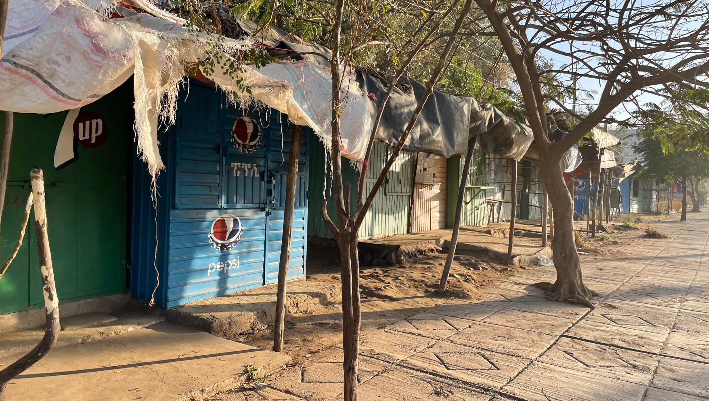
Questions

