Slide 1
Welcome to PSEAH Risk Identification and System Development Webinar
የወሲባዊ ብዝበዛ፣ ጥቃት እና ትንኮሳ አደጋ ስጋት ልየታ እና ሲስተም ዝርጋታ ዌቢናር
እንኳን ደህና መጡ!
We will be starting shortly
ከአፍታ ቆይታ በኋላ እንጀምራለን
Housekeeping / ጠቃሚ ማሳሰቢያዎች
You are on mute with video off to support the connection
የኢንተርኔት ግንኙነቱን እንዳያስተጓጉለው የተሳታፊዎች ማይክራፎና የቪድዮ ምስል የተዘጋ መሆኑን መግለጽ እንወዳለን፡፡
Chat is enabled to panelists to support with tech issues
የቴክኒክ ጉዳዮችን ለማገዝ እንዲረዳን የጽሁፍ መነጋገሪያው ለፓናል ተሳታፊዎች ብቻ የተከፈተ ይሆናል።
Use the Q&A function to ask questions throughout the presentations. It is in the controls panel on the bottom of your screen
በስክሪናችሁ የታችኛው ክፍል በሚገኘው የኮንትሮል ፓኔል ውስጥ Q&A የሚል ታገኛላችሁ። ይህንን በመጠቀም ገለፃ/ፕረዘንቴሽን በሚካሄድበት ወቅት ሁሉ ጥያቄ መጠየቅ ትችላላችሁ።

Slide 2
Risks, Risk Factors, Impacts and Implications, Mitigations

Slide 3
Risk of SEAH
What is the risk of SEAH?
    Risk is the possibility of something bad happening. It involves uncertainty about the effects/implications of an activity with respect to something that has undesirable consequences.
    Risk is a product of probability and Impact (R=PXI)
    When there is a risk that has not been addressed properly in regards to SEAH, the possibility of actual or attempted abuse of a position of vulnerability, power, or trust, for sexual purposes and sexual harassment in the workplace will be there.
3 |

Slide 4
Managing the risk of SEAH
The systematic approach applied to reduce the probability and impact of Risk associated with SEAH
The Steps to manage risks
    Step 1: Identify the Risk of SEAH
    Step 2: Analyze the Risk of SEAH-
    Step 3: Evaluate or Rank the Risk of SEAH
    Step 4: Treat the Risk of SEAH
    Step 5: Monitor and Review the Risk. ...
4 |

Slide 5
How to reduce the risk of SEAH
Risk can be reduced in managing the probability of occurrence and its impact.
The probability of concurrence of SEAH can be managed with preventive mechanisms, e.g. Policy and Procedures
The impact can be managed with reporting the incident, counseling and providing support to the victims

Slide 6
Risk Factors or Red Flags of SEAH Risks
Factors/Red Flags
    Lack of meaningful data
    Conflict areas
    Shortage of guidance
    Privacy of workspace
Factors/ Red Flags
    Knowledge of grievance procedure
    Unprofessional working environment
    Hostile Work Environment

Slide 7
Consequences of Risks of SEAH
EMOTIONAL EFFECTS
      Emotional trauma can be as disabling to a person as a visible, physical wound. Sexual harassment is humiliating and degrading, and can cause victims to suffer a loss of self-confidence and self-esteem.
      Loss of Reputation
PHYSICAL EFFECTS
      The victim may not realize it, but emotional distress can—and often does—have a direct effect on other bodily functions. Sleeplessness may lead to fatigue, which may contribute to aches, pains, or increased susceptibility to illness.
      Loss of business
ECONOMIC EFFECTS
    Sexual harassment may have severe economic effects on a victim. A woman may be denied training opportunities, a promotion, or a raise. In retaliation for complaining, she may be reassigned to a difficult position or transferred away from her family and support.
Loss of Reputation
Loss of Business

Slide 8

What should be done
    EXTRA CARE IN RECRUITMENT
    For example, demanding a clearance report from police
    AN SEAH POLICY
    An employer should have an SEAH policy that clearly explains to all employees that SEAH will not be tolerated by any employee, supervisor, coworker, customer, contractor, or anyone else who conducts business with the employer.

Slide 9
What should be done
    AN SEAH POLICY SHOULD:
      clearly define SEAH;
      include specific examples of unlawful behavior;
      provide confidentiality for those who report or assist in the investigation SEAH.

Slide 10
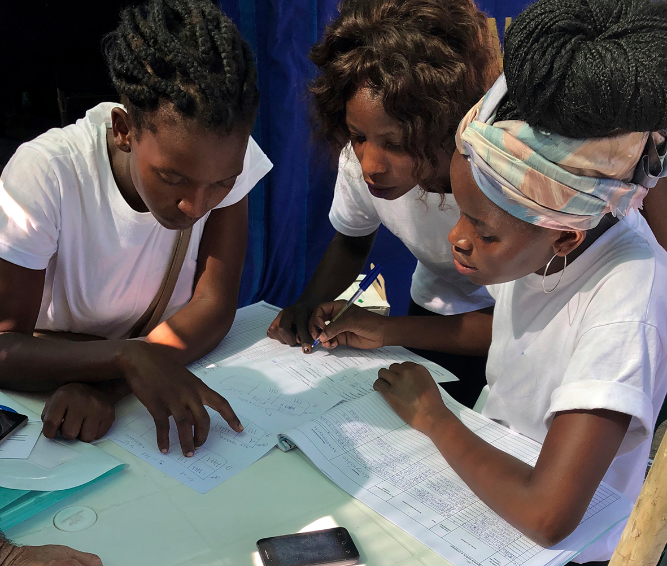
What should be done
    COMPLAINT PROCEDURES
        In order to be effective, a procedure must be usable.
        Procedures that encourage reporting are critical to an effective policy.
    INVESTIGATION
        Organizations are required to promptly investigate whether a complaint is valid, and if it is, determine what should be the appropriate remedy.

Slide 11
What should be done
    DISCIPLINE
        Most organizations have general disciplinary policies, but the SEAH policy should include the specific potential discipline for violating the policy.
    EDUCATION AND TRAINING
        Organizations should provide inducation and annual training for all workers on its sexual harassment policies and procedures.

Slide 12
How to conduct effective risk assessment and systems

Slide 13
Effective Safeguarding Risk assessment
Consideration of major safeguarding pillars in risk assessment process
Awareness
At different level (e.g. Beneficiaries, partners , staffs etc.)
Prevention
Policy
Code of conduct
Safe recruitment and personnel
Safe programing
Accountability and monitoring
Reporting
Local reporting procedure
Response
Implementation in local contexts
Referral
Investigation

Slide 14
Overview of Simplified PSEAH Risk assessment tool
What is the purpose of the tool?
    Part of preventative measures for PSEAH violence
    A simplified and user friendly tool that reflects local context
      Risks are specific to Ethiopian context
      Translated into local language
    Provides the right recommendations for the possible mitigation strategy

Slide 15
Overview of Simplified PSEAH Risk assessment tool
Where can we apply the risk assessment tool?
Projects/programme implementation contexts
Operational contexts
  Recruitment
  Logistics (overall supply chain process)
  Financial management and support functions
Partnerships
  Pre and post sub-granting

Slide 16
Overview of Simplified PSEAH Risk assessment tool
When can we apply the risk assessment tool?
During design phase
During Implementation phase
Regularly
(as part MEAL framework)

Slide 17
Key Contents of PSEAH risk assessment tool
    Three Major sections
    Background information
        Brief definition of PSEA
        Purpose and application of the tool
        Guide on how to use the tool
    The main risk assessment
        Possible risks in line with category of expectation and considering local context
        Means of Verification for the risk status
        Proposed /planned mitigation measures
        Identification of ultimate risk owner
    Summary of rating on the risk status

Slide 18
Key Contents of PSEAH risk assessment tool
Possible risks | Category of safeguarding expectation | Description of expectation | Not at all (0) | Partially 1 | Fully 2 | Comment on how you meet the indicator and attach evidence (Means of Verification) | Planned remedial/mitigation measures (for those expectation under the status of ‘ Not at all ’ & ‘ Partially ’ ) | Risk Owner (eg. Project Manager, HR personnel, MEAL personnel etc.)
 | Awareness
 | Prevention & Safe programming
 | Reporting
 | Responding

Slide 19
Key Contents of PSEAH risk assessment tool
Risk rating summary
Total Score
High Risk = Score 1- 7
Medium Risk = Score 8- 15
Low Risk = Scores 16-20

Slide 20
Key Contents of PSEA risk assessment tool
Checklist for required components in Safeguarding Policy
Include a definition of what it covers, e.g. PSEAH
Explain who is covered by the policy (scope)
Organization’s zero tolerance policy for staff, volunteers, partners and contractors
Outline the responsibilities of the organization
Outline the responsibilities of staff

Slide 21
Key Contents of PSEA risk assessment tool
Checklist for required components in Safeguarding Policy
Clearly state what conducts are prohibited
Linking with whistleblower procedure
Include additional guidelines on behavior with children
Listing of vulnerable peoples and level of contact with program staffs

Slide 22
For more information: Contact
  Semhal Getachew
  Email: Semhal@rshub.org.uk
  OR check out our Hub on
  http://safeguardingsupporthub.org/ethiopia
  We will have more coming on Twitter, Facebook, LinkedIn and Youtube

